Slide 1
Binary Trees
A binary tree is made up of a finite set of nodes that is either empty or consists of a node called the root together with two binary trees, called the left and right subtrees, which are disjoint from each other and from the root.
Notes:
Note that this means every node has two children, either or both of which can be empty. Technically, leaf nodes have two empty children.

Slide 2
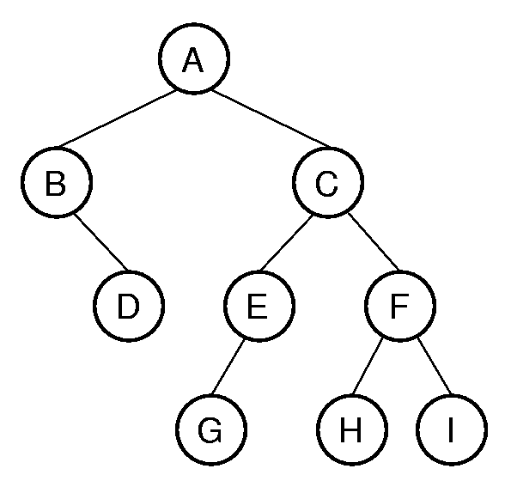
Binary Tree Example
Notation: Node, children, edge, parent, ancestorسلف, descendantاحفاد, path, depth, height, level, leaf node, internal node, subtree.

Slide 3
Binary Tree :depth
In a tree, the number of edges from the root node to a particular node is called the depth of the node.
In the tree, the number of edges from the root node to the leaf node in the longest path is known as "Depth of Tree".
In the tree data structures, the depth of the root node is 0..
A has depth 0.
C has depth 1.
I has depth is 3.

Slide 4
Binary Tree :Hight
The height of a node is the number of edges on the longest path from the node to a leaf.
A leaf node will have a height of 0.
A has Hight 3.
C has hight 2.
I has hight is 0.
The height of the tree is the number of edges in the tree from the root to the deepest node plus 1.
The height of the tree is 3+1=4

Slide 5
Binary Tree :level
All nodes of depth d are at level d in the tree.
The root is the only node at level 0, and its depth is 0.
A leaf node is any node that has two empty children.
An internal node is any node
that has at least one non-empty child.

Slide 6
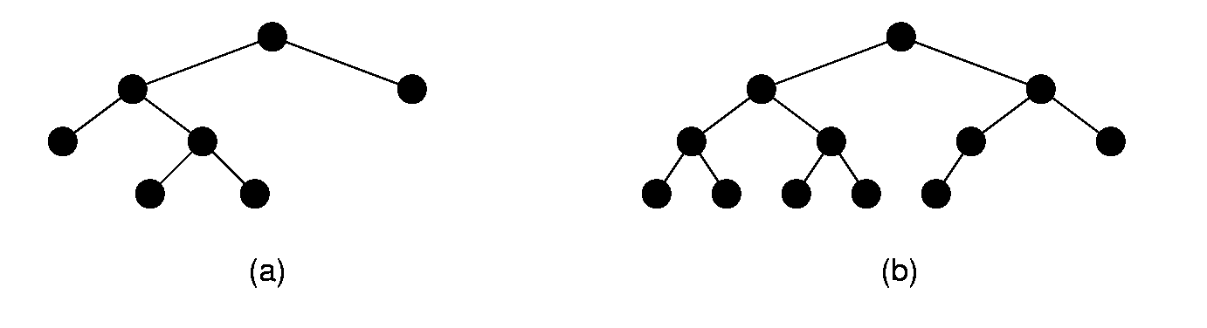
Full and Complete Binary Trees
Full binary tree: Each node is either a leaf or internal node with exactly two non-empty children.
Complete binary tree: If the height of the tree is d, then all leaves except possibly level d are completely full. The bottom level has all nodes to the left side.
Notes:
These terms can be hard to distinguish. Students will need to remember which is which, since this notation will be used several times during the course.

Slide 7
Full Binary Tree Theorem (1)
Theorem: The number of leaves in a non-empty full binary tree is one more than the number of internal nodes.
Proof (by Mathematical Induction):
Base case: A full binary tree with 1 internal node must have two leaf nodes.
Induction Hypothesis: Assume any full binary tree T containing n-1 internal nodes has n leaves.
Notes:
This theorem is important, because it helps us to calculate space requirements. It tells us how many nodes are internal and how many are leaf. We need to know this if we have separate implementations for internal and leaf nodes

Slide 8
Full Binary Tree Corollaryنتيجة طبيعية كاملة للشجرة الثنائية
Theorem: The number of null pointers in a non-empty tree is one more than the number of nodes in the tree.
Proof: Replace all null pointers with a pointer to an empty leaf node. This is a full binary tree.

Slide 9
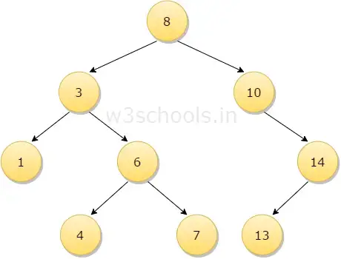
Theorem 5.2
Theorem 5.2 The number of empty subtrees in a non-empty binary tree is one more than the number of nodes in the tree

Slide 10
Binary Tree Node Class
ADT

Slide 11
Binary Tree Node ADT
/** ADT for binary tree nodes */
public interface BinNode<E> {
/** Return and set the element value */
public E element();
public E setElement(E v);
/** Return the left child */
public BinNode<E> left();
/** Return the right child */
public BinNode<E> right();
/** Return true if this is a leaf node */
public boolean isLeaf();
}

Slide 12
Traversals (1)
Any process for visiting the nodes in some order is called a traversal.
Any traversal that lists every node in the tree exactly once is called an enumeration of the tree’s nodes.

Slide 13
Traversals (2)
Preorder traversal: Visit each node before visiting its children.
Postorder traversal: Visit each node after visiting its children.
Inorder traversal: Visit the left subtree, then the node, then the right subtree.

Slide 14
Traversals (3)
/** @param rt The root of the subtree */
void preorder(BinNode rt)
{
if (rt == null) return; // Empty subtree
visit(rt);
preorder(rt.left());
preorder(rt.right());
}
// This implementation is error prone
void preorder(BinNode rt) // Not so good
{
visit(rt);
if (rt.left() != null) preorder2(rt.left());
if (rt.right() != null) preorder2(rt.right());
}
Notes:
The first implementation is preferred.
The second implementation illustrates a common programming style by many students. It attempts to “look ahead” at the node to be called to determine if it is null or not. This is highly error prone, because the calling function must make sure not to pass in a null pointer for the tree root. It might appear to be more efficient (since it does not make recursive calls on the empty pointers), but it is not in reality since it is checking the pointers twice (to see if not null, then to process them).

Slide 15
Recursion Examples
int count(BinNode rt) {
if (rt == null) return 0;
return 1 + count(rt.left()) +
count(rt.right());
}

Slide 16
Recursion Examples
boolean checkBST(BinNode<Integer> rt,
Integer low, Integer high) {
if (rt == null) return true;
Integer rootkey = rt.key();
if ((rootkey < low) || (rootkey > high))
return false; // Out of range
if (!checkBST(rt.left(), low, rootkey))
return false; // Left side failed
return checkBST(rt.right(), rootkey, high);
}

Slide 17
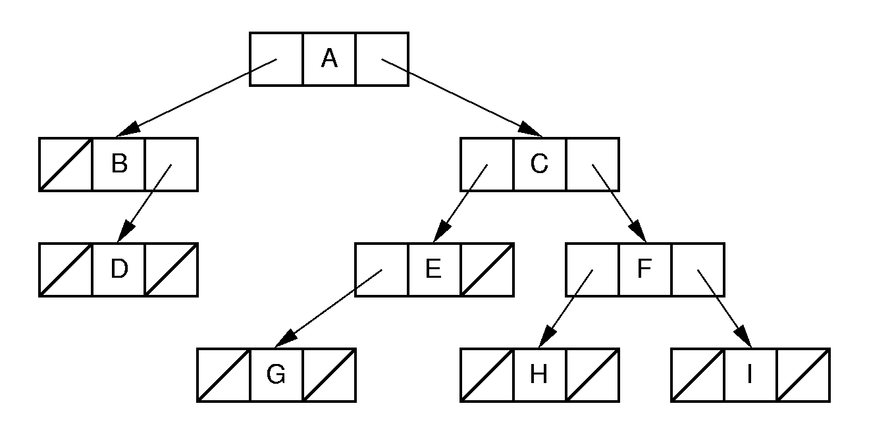
Binary Tree Implementation (1)
Standard implementation.
Leaf implementation is identical to internal node implementation, resulting in much wasted space due to null pointers.
In fact, we know from the full binary tree theorem that half of the pointers are null.
Notes:
Standard implementation. Leaf implementation is identical to internal node implementation, resulting in much wasted space due to null pointers. In fact, we know from the full binary tree theorem that half of the pointers are null.

Slide 18
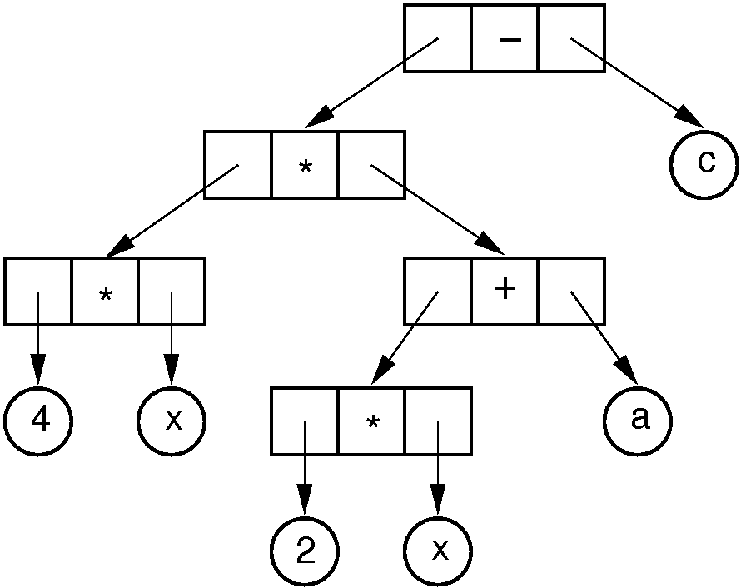
Binary Tree Implementation (2)
Example of a tree with distinct internal and leaf node implementations
Notes:
Example of a tree with distinct internal and leaf node implementations.

Slide 19
Inheritance (1)
/** Base class */
public interface VarBinNode {
public boolean isLeaf();
}
/** Leaf node */
class VarLeafNode implements VarBinNode {
private String operand;
public VarLeafNode(String val)
{ operand = val; }
public boolean isLeaf() { return true; }
public String value() { return operand; }
};

Slide 20
Inheritance (2)
/** Internal node */
class VarIntlNode implements VarBinNode {
private VarBinNode left;
private VarBinNode right;
private Character operator;
public VarIntlNode(Character op,
VarBinNode l, VarBinNode r)
{ operator = op; left = l; right = r; }
public boolean isLeaf() { return false; }
public VarBinNode leftchild() { return left; }
public VarBinNode rightchild(){ return right; }
public Character value() { return operator; }
}

Slide 21
Inheritance (3)
/** Preorder traversal */
public static void traverse(VarBinNode rt) {
if (rt == null) return;
if (rt.isLeaf())// base case
Visit.VisitLeafNode(((VarLeafNode)rt).value());
else {
Visit.VisitInternalNode(
((VarIntlNode)rt).value());
traverse(((VarIntlNode)rt).leftchild());
traverse(((VarIntlNode)rt).rightchild());
}
}

Slide 22
Design Patterns
Design patterns capture reusable pieces of design wisdom.
Goals:
Quickly communicate design wisdom to new designers
Give a shared vocabulary to designers

Slide 23
Composite Design Pattern (1)
/* Base class: Composite */
public interface VarBinNode {
public boolean isLeaf();
public void traverse();
}
/* Leaf node: Composite */
class VarLeafNode implements VarBinNode {
private String operand;
public VarLeafNode(String val)
{ operand = val; }
public boolean isLeaf() { return true; }
public String value() { return operand; }
public void traverse()
{ Visit.VisitLeafNode(operand); }
}

Slide 24
Composite (2)
/** Internal node: Composite */
class VarIntlNode implements VarBinNode {
private VarBinNode left;
private VarBinNode right;
private Character operator;
public VarIntlNode(Character op,
VarBinNode l, VarBinNode r)
{ operator = op; left = l; right = r; }
public boolean isLeaf() { return false; }
public VarBinNode leftchild() { return left; }
public VarBinNode rightchild()
{ return right; }
public Character value() { return operator; }
public void traverse() {
Visit.VisitInternalNode(operator);
if (left != null) left.traverse();
if (right != null) right.traverse();
}
}

Slide 25
Composite (3)
/** Preorder traversal */
public static void traverse(VarBinNode rt) {
if (rt != null) rt.traverse();
}

Slide 26
Space Overhead (1)
From the Full Binary Tree Theorem:
Half of the pointers are null.
If leaves store only data, then overhead depends on whether the tree is full.
Ex: Full tree, all nodes the same, with two pointers to children and one to element(parent):
Total space required is (3p + d)n
Overhead: 3pn
If p = d, this means 3p/(3p + d) = 3/4 overhead.

Slide 27
Space Overhead (2)
Eliminate pointers from the leaf nodes:
n/2(2p) p
n/2(2p) + dn p + d
This is 1/2 if p = d.
(2p)/(2p + d) if data only at leaves ⇒ 2/3 overhead.
Note that some method is needed to distinguish leaves from internal nodes.
=
نصف العقد فيها موشر فقط n/2(2p)
كل العقد هي n/2(2p)+dn
Notes:
This example is for full binary trees.
Half of the nodes have 2 pointers, which is overhead.
The mechanism for distinguishing leaves from internal nodes adds additional overhead not accounted for here.
Great savings can be had by eliminating the pointers from leaf nodes in full binary trees.
Again assume the tree stores a reference to the data field. Because about half of the nodes are leaves and half internal nodes, and because only internal nodes now have child pointers, the overhead fraction in this case will be approximately.

Slide 28
CH5

